Slide 1
Database Normalization
ISTA 322 - Data Engineering

Slide 2
What is normalization?
I’ve referred to it a lot but haven’t directly explained.
Normalization is a way to organize data in a RDB.
Follows a set of rules
Increase flexibility
Reduce redundancy
Consistent format and dependency
The rules make up a series of ‘normal forms’
Three main normal forms we’ll focus on

Slide 3
Normal forms
1st normal form
Remove repeating groups within tables
Separate tables for related data
Each set of related data should have a primary key

Slide 4
Normal forms
1st normal form
Remove repeating groups within tables
Separate tables for related data
Each set of related data should have a primary key
2nd normal form
Separate tables for values that apply to multiple records
These are related to others with a foreign key

Slide 5
Normal forms
1st normal form
Remove repeating groups within tables
Separate tables for related data
Each set of related data should have a primary key
2nd normal form
Separate tables for values that apply to multiple records
These are related to others with a foreign key
3rd normal form
Remove fields that don’t rely on the key

Slide 6
Let’s look at a simple example - Data
Table: top_track_info
artist_name | artist_id | song_id | song_name | streams | genre_1 | genre_2 | followers
Dance w/t Dead | x88928 | a99189 | diabolic | 75092 | synthwave | darkwave | 156000
Dance w/t Dead | x88928 | a73198 | invader | 93910 | synthwave | darkwave | 156000
Frank Sinatra | z99029 | a23812 | witchcraft | 21048820 | traditional |  | 12020900
Frank Sinatra | z99029 | a83012 | angel eyes | 14029901 | traditional |  | 12020900
ODESZA | y88420 | a01818 | Meridian | 5401928 | electronic | indie | 6800700
ODESZA | y88420 | a01912 | Bloom | 5691321 | electronic | indie | 6800700
Sample non-normal data
Might be good for analysis
Common format for CSV/excel
But lots and lots of extra info
Difficult to update/change

Slide 7
Let’s look at a simple example - 1NF
Table: top_track_info
artist_name | artist_id | song_id | song_name | streams | genre_1 | genre_2 | followers
Dance w/t Dead | x88928 | a99189 | diabolic | 75092 | synthwave | darkwave | 156000
Dance w/t Dead | x88928 | a73198 | invader | 93910 | synthwave | darkwave | 156000
Frank Sinatra | z99029 | a23812 | witchcraft | 21048820 | traditional |  | 12020900
Frank Sinatra | z99029 | a83012 | angel eyes | 14029901 | traditional |  | 12020900
ODESZA | y88420 | a01818 | Meridian | 5401928 | electronic | indie | 6800700
ODESZA | y88420 | a01912 | Bloom | 5691321 | electronic | indie | 6800700
Repeating groups
List of data in a column/field
Or multiple fields with the same data
Must ‘stack’ columns

Slide 8
Let’s look at a simple example - 1NF
Table: top_track_info
artist_name | artist_id | song_id | song_name | streams | genre | followers
Dance w/t Dead | x88928 | a99189 | diabolic | 75092 | synthwave | 156000
Dance w/t Dead | x88928 | a73198 | invader | 93910 | synthwave | 156000
Dance w/t Dead | x88928 | a99189 | diabolic | 75092 | darkwave | 156000
Dance w/t Dead | x88928 | a73198 | invader | 93910 | darkwave | 156000
Frank Sinatra | z99029 | a23812 | witchcraft | 21048820 | traditional | 12020900
Frank Sinatra | z99029 | a83012 | angel eyes | 14029901 | traditional | 12020900
ODESZA | y88420 | a01818 | Meridian | 5401928 | electronic | 6800700
ODESZA | y88420 | a01912 | Bloom | 5691321 | electronic | 6800700
ODESZA | y88420 | a01818 | Meridian | 5401928 | indie | 6800700
ODESZA | y88420 | a01912 | Bloom | 5691321 | indie | 6800700
Repeating groups
List of data in a column/field
Or multiple fields with the same data
Must ‘stack’ columns

Slide 9
Let’s look at a simple example - 1NF
Table: artist_genre
artist_id | genre
x88928 | synthwave
x88928 | darkwave
z99029 | traditional
y88420 | electronic
y88420 | indie
Table: top_track_info
artist_name | artist_id | song_id | song_name | streams | genre | followers
Dance w/t Dead | x88928 | a99189 | diabolic | 75092 | synthwave | 156000
Dance w/t Dead | x88928 | a73198 | invader | 93910 | synthwave | 156000
Dance w/t Dead | x88928 | a99189 | diabolic | 75092 | darkwave | 156000
Dance w/t Dead | x88928 | a73198 | invader | 93910 | darkwave | 156000
Frank Sinatra | z99029 | a23812 | witchcraft | 21048820 | traditional | 12020900
Frank Sinatra | z99029 | a83012 | angel eyes | 14029901 | traditional | 12020900
ODESZA | y88420 | a01818 | Meridian | 5401928 | electronic | 6800700
ODESZA | y88420 | a01912 | Bloom | 5691321 | electronic | 6800700
ODESZA | y88420 | a01818 | Meridian | 5401928 | indie | 6800700
ODESZA | y88420 | a01912 | Bloom | 5691321 | indie | 6800700
Repeating groups
Break into own table

Slide 10
Let’s look at a simple example - 1NF
Table: artist_genre
artist_id | genre
x88928 | synthwave
x88928 | darkwave
z99029 | traditional
y88420 | electronic
y88420 | indie
Table: top_track_info
artist_name | artist_id | song_id | song_name | streams | followers
Dance w/t Dead | x88928 | a99189 | diabolic | 75092 | 156000
Dance w/t Dead | x88928 | a73198 | invader | 93910 | 156000
Frank Sinatra | z99029 | a23812 | witchcraft | 21048820 | 12020900
Frank Sinatra | z99029 | a83012 | angel eyes | 14029901 | 12020900
ODESZA | y88420 | a01818 | Meridian | 5401928 | 6800700
ODESZA | y88420 | a01912 | Bloom | 5691321 | 6800700
Repeating groups
Break into own table
Reduce other table

Slide 11
Let’s look at a simple example
Table: artist_genre
artist_id | genre
x88928 | synthwave
x88928 | darkwave
z99029 | traditional
y88420 | electronic
y88420 | indie
Table: top_track_info
artist_name | artist_id | song_id | song_name | streams | followers
Dance w/t Dead | x88928 | a99189 | diabolic | 75092 | 156000
Dance w/t Dead | x88928 | a73198 | invader | 93910 | 156000
Frank Sinatra | z99029 | a23812 | witchcraft | 21048820 | 12020900
Frank Sinatra | z99029 | a83012 | angel eyes | 14029901 | 12020900
ODESZA | y88420 | a01818 | Meridian | 5401928 | 6800700
ODESZA | y88420 | a01912 | Bloom | 5691321 | 6800700
Foreignkey
Repeating groups
Break into own table
Reduce other table
Foreign key in artist_info
Foreign key in top_track_info
Foreign key

Slide 12
Let’s look at a simple example
Table: artist_genre
artist_id | genre
x88928 | synthwave
x88928 | darkwave
z99029 | traditional
y88420 | electronic
y88420 | indie
Table: top_track_info
artist_name | artist_id | song_id | song_name | streams | followers
Dance w/t Dead | x88928 | a99189 | diabolic | 75092 | 156000
Dance w/t Dead | x88928 | a73198 | invader | 93910 | 156000
Frank Sinatra | z99029 | a23812 | witchcraft | 21048820 | 12020900
Frank Sinatra | z99029 | a83012 | angel eyes | 14029901 | 12020900
ODESZA | y88420 | a01818 | Meridian | 5401928 | 6800700
ODESZA | y88420 | a01912 | Bloom | 5691321 | 6800700
Foreignkey
Repeating groups
Break into own table
Reduce other table
Foreign key in artist_info
Foreign key in top_track_info
Foreign key
Primary
key

Slide 13
Let’s look at a simple example - 2NF
Table: artist_genre
artist_id | genre
x88928 | synthwave
x88928 | darkwave
z99029 | traditional
y88420 | electronic
y88420 | indie
Table: top_track_info
artist_name | artist_id | song_id | song_name | streams | followers
Dance w/t Dead | x88928 | a99189 | diabolic | 75092 | 156000
Dance w/t Dead | x88928 | a73198 | invader | 93910 | 156000
Frank Sinatra | z99029 | a23812 | witchcraft | 21048820 | 12020900
Frank Sinatra | z99029 | a83012 | angel eyes | 14029901 | 12020900
ODESZA | y88420 | a01818 | Meridian | 5401928 | 6800700
ODESZA | y88420 | a01912 | Bloom | 5691321 | 6800700
Redundant info
Artist info isn’t dependent on song info

Slide 14
Let’s look at a simple example - 2NF
Table: artist_genre
artist_id | genre
x88928 | synthwave
x88928 | darkwave
z99029 | traditional
y88420 | electronic
y88420 | indie
Table: top_track_info
artist_id | song_id | song_name | streams | followers
x88928 | a99189 | diabolic | 75092 | 156000
x88928 | a73198 | invader | 93910 | 156000
z99029 | a23812 | witchcraft | 21048820 | 12020900
z99029 | a83012 | angel eyes | 14029901 | 12020900
y88420 | a01818 | Meridian | 5401928 | 6800700
y88420 | a01912 | Bloom | 5691321 | 6800700
Table: artist_info
artist_name | artist_id
Dance w/t Dead | x88928
Frank Sinatra | z99029
ODESZA | y88420
Redundant info
Artist info isn’t dependent on song info
Split off

Slide 15
Let’s look at a simple example - 3NF
Table: artist_genre
artist_id | genre
x88928 | synthwave
x88928 | darkwave
z99029 | traditional
y88420 | electronic
y88420 | indie
Table: top_track_info
artist_id | song_id | song_name | streams | followers
x88928 | a99189 | diabolic | 75092 | 156000
x88928 | a73198 | invader | 93910 | 156000
z99029 | a23812 | witchcraft | 21048820 | 12020900
z99029 | a83012 | angel eyes | 14029901 | 12020900
y88420 | a01818 | Meridian | 5401928 | 6800700
y88420 | a01912 | Bloom | 5691321 | 6800700
Table: artist_info
artist_name | artist_id
Dance w/t Dead | x88928
Frank Sinatra | z99029
ODESZA | y88420
Remove data not dependent on key
Followers isn’t dependent on key of song_id
Make own table?
Add to artist_info

Slide 16
Let’s look at a simple example - 3NF
Table: artist_genre
artist_id | genre
x88928 | synthwave
x88928 | darkwave
z99029 | traditional
y88420 | electronic
y88420 | indie
Table: top_track_info
artist_id | song_id | song_name | streams
x88928 | a99189 | diabolic | 75092
x88928 | a73198 | invader | 93910
z99029 | a23812 | witchcraft | 21048820
z99029 | a83012 | angel eyes | 14029901
y88420 | a01818 | Meridian | 5401928
y88420 | a01912 | Bloom | 5691321
Table: artist_info
artist_name | artist_id | followers
Dance w/t Dead | x88928 | 156000
Frank Sinatra | z99029 | 12020900
ODESZA | y88420 | 6800700
Remove data not dependent on key
Followers isn’t dependent on key of song_id
Make own table?
Add to artist_info?

Slide 17
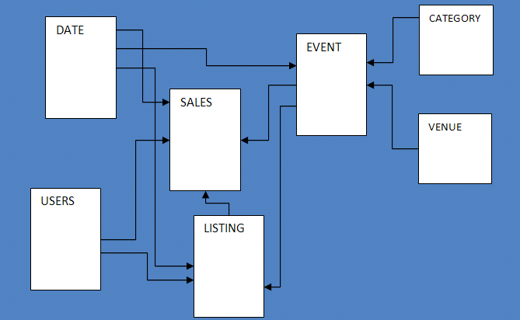
Creating a schema
Arrangement of tables is called a schema
Look at head of raw data
Hand draw tables to normalize
Or list columns
Schema of sales data

Slide 18
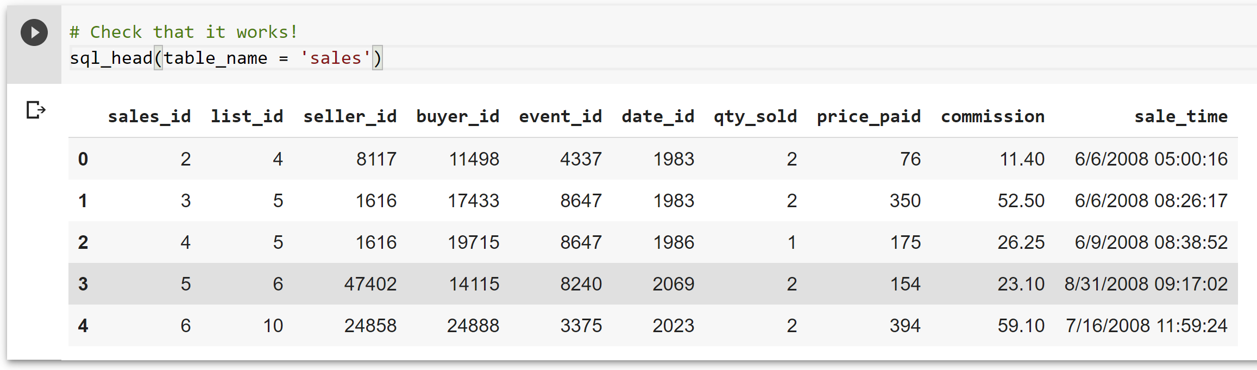
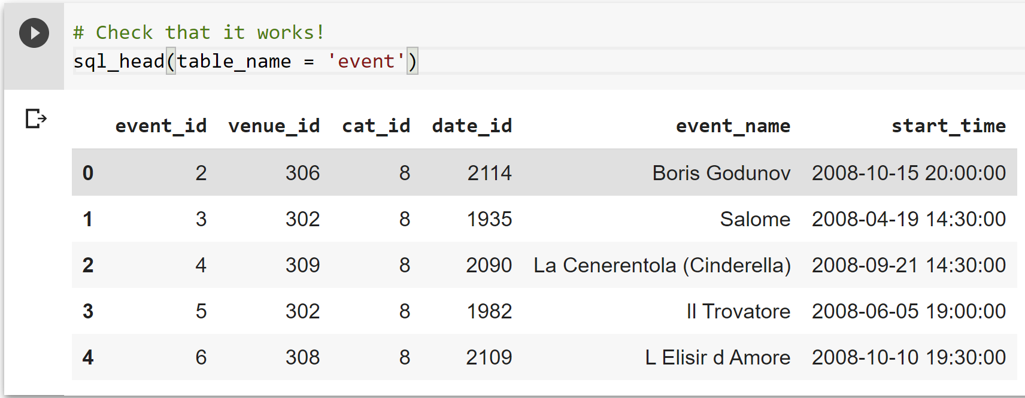

Slide 19
Doing this in Python
Split into different dataframes by selecting columns
Reduce rows if needed!
drop_duplicates() is helpful!
Generate keys before or after split?
Connect to RDB and upload

Slide 20
Doing this in Python
Table: artist_genre
artist_id | genre
x88928 | synthwave
x88928 | darkwave
z99029 | traditional
y88420 | electronic
y88420 | indie
Table: top_track_info
artist_name | artist_id | song_id | song_name | streams | genre | followers
Dance w/t Dead | x88928 | a99189 | diabolic | 75092 | synthwave | 156000
Dance w/t Dead | x88928 | a73198 | invader | 93910 | synthwave | 156000
Dance w/t Dead | x88928 | a99189 | diabolic | 75092 | darkwave | 156000
Dance w/t Dead | x88928 | a73198 | invader | 93910 | darkwave | 156000
Frank Sinatra | z99029 | a23812 | witchcraft | 21048820 | traditional | 12020900
Frank Sinatra | z99029 | a83012 | angel eyes | 14029901 | traditional | 12020900
ODESZA | y88420 | a01818 | Meridian | 5401928 | electronic | 6800700
ODESZA | y88420 | a01912 | Bloom | 5691321 | electronic | 6800700
ODESZA | y88420 | a01818 | Meridian | 5401928 | indie | 6800700
ODESZA | y88420 | a01912 | Bloom | 5691321 | indie | 6800700
artist_genre = top_track_info[[
‘artist_id’, ‘genre’]]
artist_genre =
artist_genre.
drop_duplicates()

Slide 21
Normalization isn’t the only way
Star and Snowflake schema
Fact table
Core measurements
e.g. Sales/bookings/listens
Highly granular
Foreign keys to dimension tables
Dimension table
Descriptions of elements in fact table
Often used in data warehouses

Slide 22
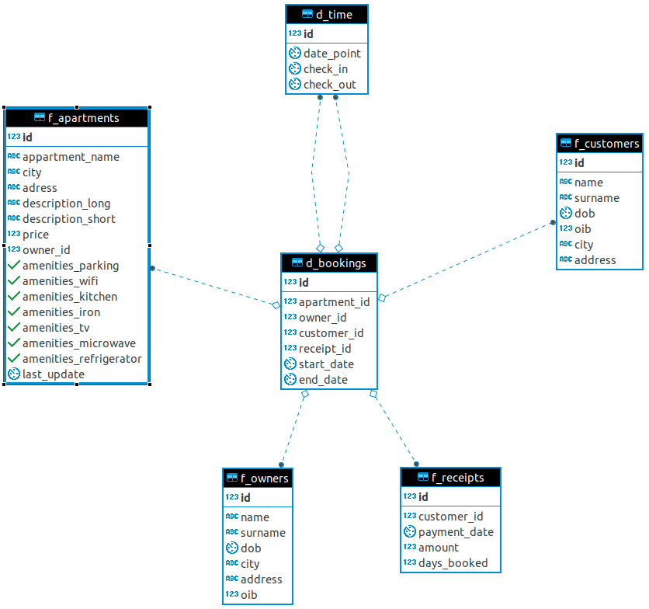
Star Schema
AirBnB
Fact
bookings
Dimensions
apartments
time
customer

Slide 23
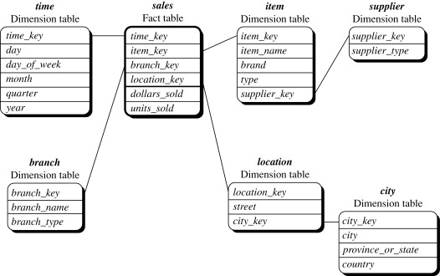
Snowflake Schema
Similar to Star
Further normalization in dimension tables

Slide 24
Wrapping up Normalization
Normalization is key to making a database stable, maintainable, and efficient.
Tradeoffs are made regarding how far you want to normalize
Could balloon into tons of tables
Standard normalization is not the only way!
This is not a RDB design class.

